Slide 1
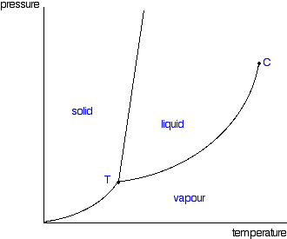
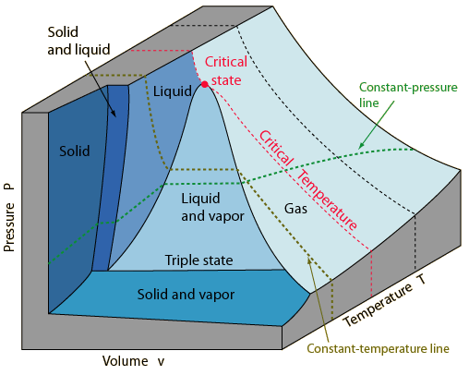

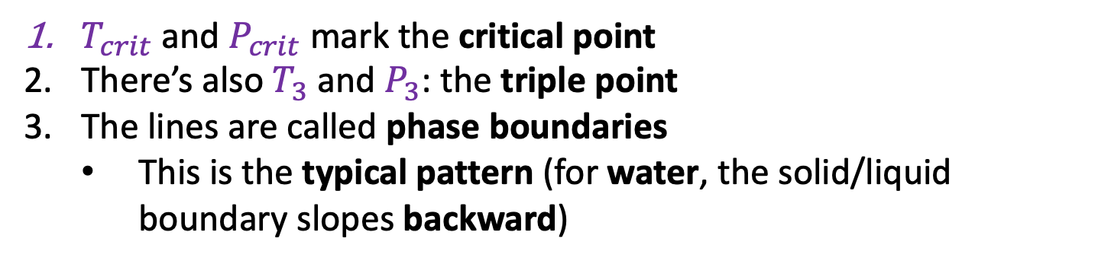
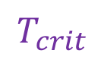
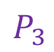
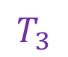
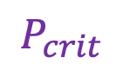
Week 9 – Phase diagrams
$$P_{crit}$$
$$P_{3}$$
$$T_{3}$$
$$T_{crit}$$
This is a typical phase diagram
$T_{crit}$ and $P_{crit}$ mark the critical point
There’s also $T_{3}$ and $P_{3}$: the triple point
The lines are called phase boundaries
This is the typical pattern (for water, the solid/liquid boundary slopes backward)

Slide 2
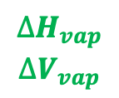
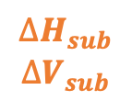
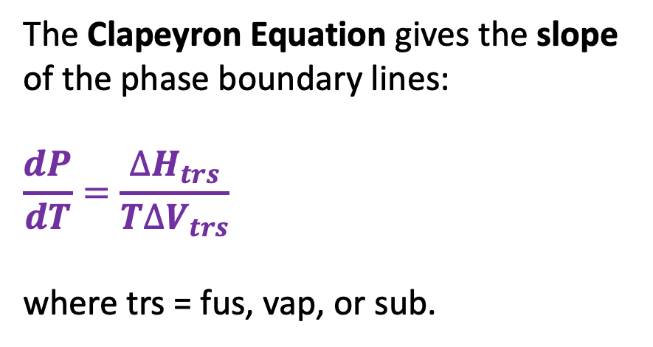
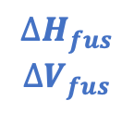
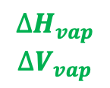
Week 9 – The Clapeyron equation
The Clapeyron Equation gives the slope of the phase boundary lines:
$$\frac{dP}{dT}=\frac{∆H_{trs}}{T∆V_{trs}}$$
where trs = fus, vap, or sub.
$$∆H_{fus}$$
$$∆V_{fus}$$
P
$$∆H_{vap}$$
$$∆V_{vap}$$
$$∆H_{vap}$$
$$∆V_{vap}$$
$$∆H_{sub}$$
$$∆V_{sub}$$
T

Slide 3
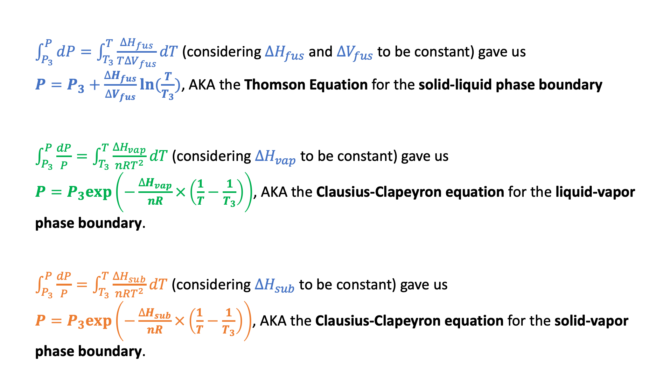
Week 9 – How Clapeyron integrated to Thomson and Clausius-Clapeyron
$\int_{P_{3}}^{P}{dP}=\int_{T_{3}}^{T}{\frac{∆H_{fus}}{T∆V_{fus}}dT}$ (considering $∆H_{fus}$ and $∆V_{fus}$ to be constant) gave us
$P=P_{3}+\frac{∆H_{fus}}{∆V_{fus}}ln⁡(\frac{T}{T_{3}})$, AKA the Thomson Equation for the solid-liquid phase boundary
$\int_{P_{3}}^{P}{\frac{dP}{P}}=\int_{T_{3}}^{T}{\frac{∆H_{vap}}{nRT^{2}}dT}$ (considering $∆H_{vap}$ to be constant) gave us
$P=P_{3}exp⁡\left(−\frac{∆H_{vap}}{nR}×\left(\frac{1}{T}−\frac{1}{T_{3}}\right)\right)$, AKA the Clausius-Clapeyron equation for the liquid-vapor phase boundary.
$\int_{P_{3}}^{P}{\frac{dP}{P}}=\int_{T_{3}}^{T}{\frac{∆H_{sub}}{nRT^{2}}dT}$ (considering $∆H_{sub}$ to be constant) gave us
$P=P_{3}exp⁡\left(−\frac{∆H_{sub}}{nR}×\left(\frac{1}{T}−\frac{1}{T_{3}}\right)\right)$, AKA the Clausius-Clapeyron equation for the solid-vapor phase boundary.

Slide 4
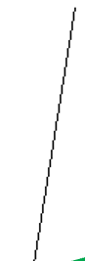
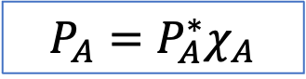


Week 9 – How Raoult’s Law relates $P_{A}$ to $P_{A}^{∗}$
P
A(g)
${P_{A}=P}_{A}^{∗}χ_{A}$
New equilibrium
A
$$P_{A}^{∗}$$
B
A
A
A
A
Solvent A with solute B
B
$$P_{A}$$
A
A
T
Here, $χ_{A}$ is the mole fraction of solvent A in the solution,
$χ_{A}≡\frac{n_{A}}{n_{A}+n_{B}}$. A handy formula: $χ_{A}=\frac{1}{1+M_{A}b_{B}}$ where $b_{B}≡\frac{mol B}{kg A}$ is the solute’s molality.

Slide 5
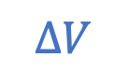

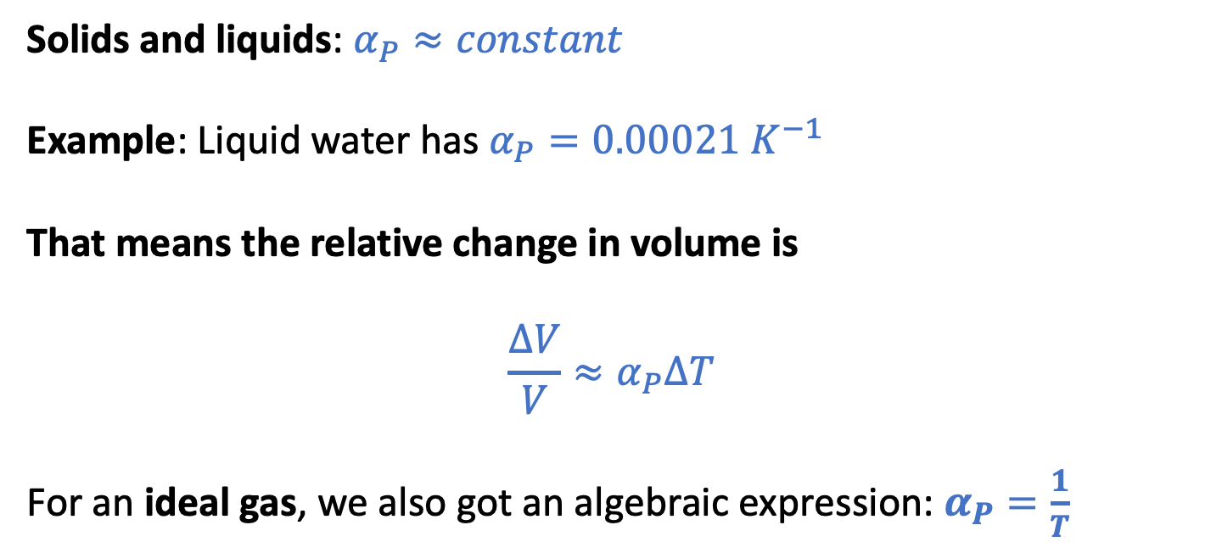
Week 9 – The isobaric thermal expansivity, $α_{P}$
$α_{P}≡\frac{1}{V}{\left(\frac{∂V}{∂T}\right)}_{P}$ … for small changes in temperature, we can say $\frac{∆V}{V}=\frac{∆ρ}{ρ}≈{−κ}_{T}∆P$
$$∆V$$
Solids and liquids: $α_{P}≈constant$
Example: Liquid water has $α_{P}=0.00021{ K}^{−1}$
That means the relative change in volume is
$${\frac{∆V}{V}≈α}_{P}∆T$$
For an ideal gas, we also got an algebraic expression: $α_{P}=\frac{1}{T}$
$$V$$

Slide 6
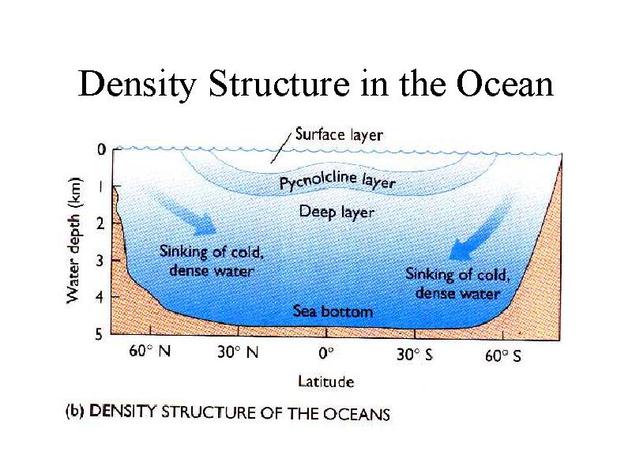
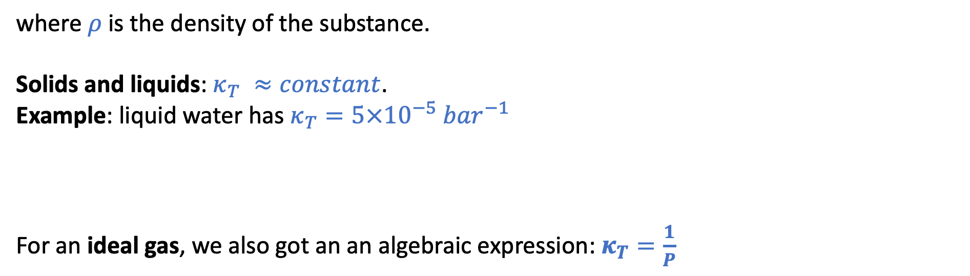
Week 9 – The isothermal compressibility, $κ_{T}$
$κ_{T}≡−\frac{1}{V}{\left(\frac{∂V}{∂P}\right)}_{T}$ … for small changes in pressure, we can say $\frac{∆V}{V}=\frac{∆ρ}{ρ}≈{−κ}_{T}∆P$
http://www.ccpo.odu.edu/~atkinson/OCN306/lec42/img019.jpg
where $ρ$ is the density of the substance.
Solids and liquids: $κ_{T} ≈constant$.
Example: liquid water has $κ_{T}=5×10^{−5}{ bar}^{−1}$
For an ideal gas, we also got an an algebraic expression: $κ_{T}=\frac{1}{P}$

Slide 7
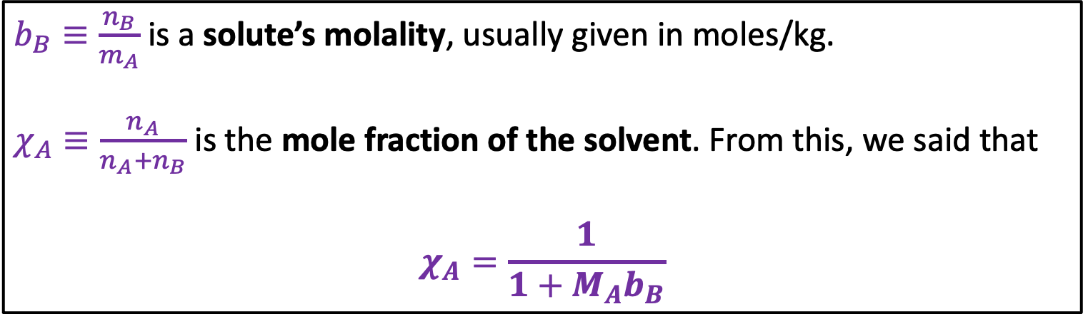
Week 9 – The relationship between molality and mole fraction
$b_{B}≡\frac{n_{B}}{m_{A}}$ is a solute’s molality, usually given in moles/kg.
$χ_{A}≡\frac{n_{A}}{n_{A}+n_{B}}$ is the mole fraction of the solvent. From this, we said that
$$χ_{A}=\frac{1}{1+M_{A}b_{B}}$$

Slide 8

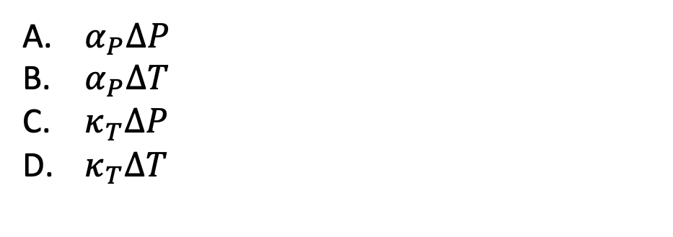
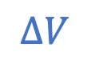

The kind of question I might ask
$α_{P}≡\frac{1}{V}{\left(\frac{∂V}{∂T}\right)}_{P}$ , $κ_{T}≡−\frac{1}{V}{\left(\frac{∂V}{∂P}\right)}_{T}$
In relation to sea level rise due to climate change, which is the relevant equation for $\frac{∆V}{V}$?
$$∆V$$
$α_{P}∆P$
$α_{P}∆T$
$κ_{T}∆P$
$κ_{T}∆T$
$$V$$

Slide 9
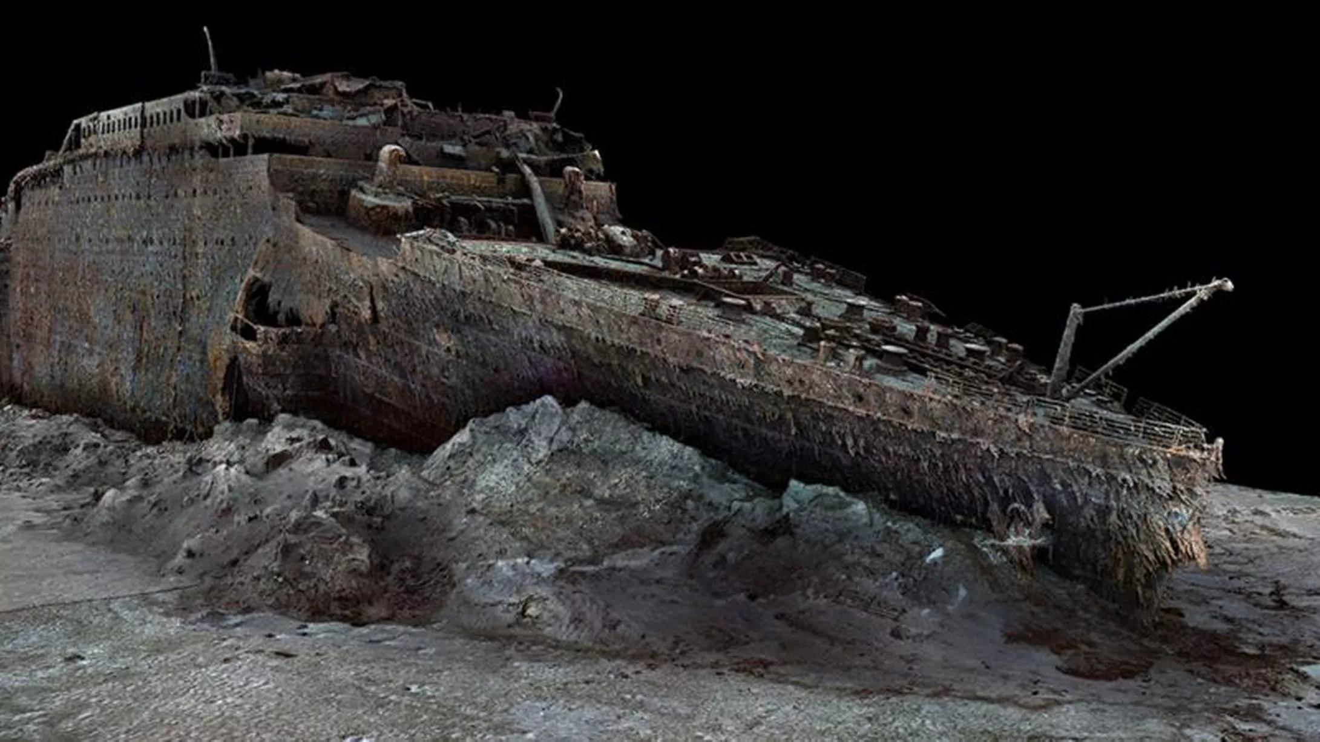
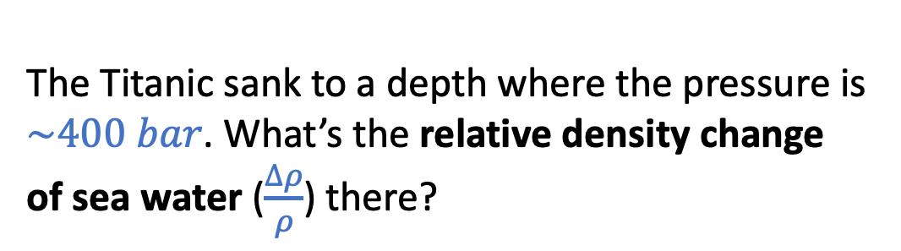
The kind of question I might ask
The Titanic sank to a depth where the pressure is $\sim 400 bar$. What’s the relative density change of sea water ($\frac{∆ρ}{ρ}$) there?
2.4 miles (13,000 feet)

Slide 10
The kind of question I might ask
P
B (line)
Clapeyron
Clausius-Clapeyron
Raoult
Thomson
Clapeyron
__________
__________
__________
C (line)
D (line)
A (slope)
T

Slide 11
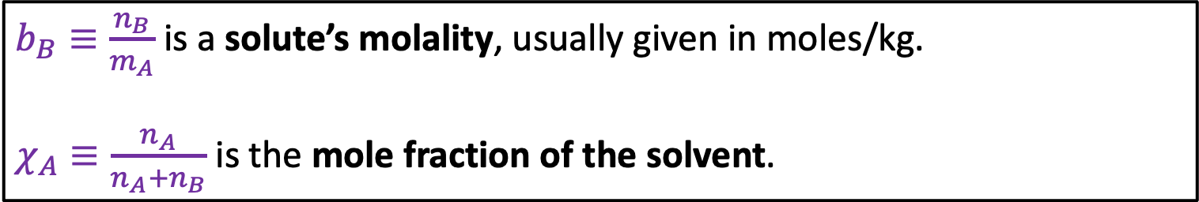
The kind of question I might ask
$b_{B}≡\frac{n_{B}}{m_{A}}$ is a solute’s molality, usually given in moles/kg.
$χ_{A}≡\frac{n_{A}}{n_{A}+n_{B}}$ is the mole fraction of the solvent.
What’s the value of $χ_{A}$ when the solvent is water and $b_{B}=2\frac{mol}{kg}$?

Slide 12
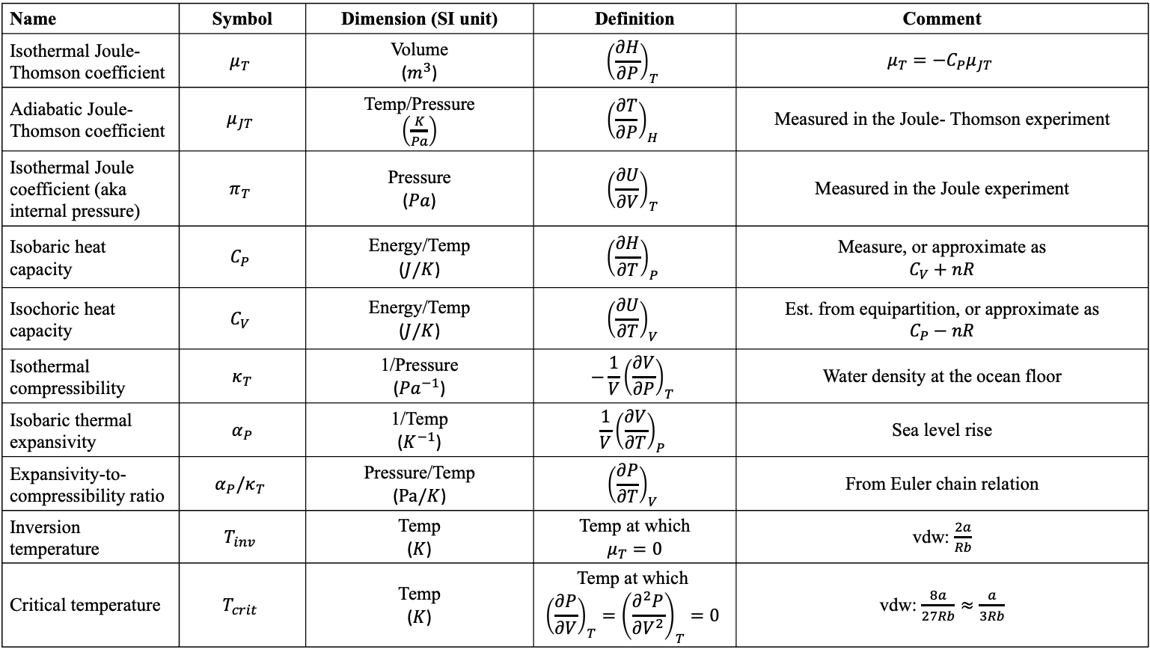
Summary of measurable quantities
Name | Symbol | Dimension (SI unit) | Definition | Comment
Isothermal Joule-Thomson coefficient | $$μ_{T}$$ | Volume ($m^{3}$) | $${\left(\frac{∂H}{∂P}\right)}_{T}$$ | $$μ_{T}=−C_{P}μ_{JT}$$
Adiabatic Joule-Thomson coefficient | $$μ_{JT}$$ | Temp/Pressure $\left(\frac{K}{Pa}\right)$ | $${\left(\frac{∂T}{∂P}\right)}_{H}$$ | Measured in the Joule- Thomson experiment
Isothermal Joule coefficient (aka internal pressure) | $$π_{T}$$ | Pressure ($Pa$) | $${\left(\frac{∂U}{∂V}\right)}_{T}$$ | Measured in the Joule experiment
Isobaric heat capacity | $$C_{P}$$ | Energy/Temp ($J/K$) | $${\left(\frac{∂H}{∂T}\right)}_{P}$$ | Measure, or approximate as $$C_{V}+nR$$
Isochoric heat capacity | $$C_{V}$$ | Energy/Temp ($J/K$) | $${\left(\frac{∂U}{∂T}\right)}_{V}$$ | Est. from equipartition, or approximate as $$C_{P}−nR$$
Isothermal compressibility | $κ_{T}$ | 1/Pressure (${Pa}^{−1}$) | $$−\frac{1}{V}{\left(\frac{∂V}{∂P}\right)}_{T}$$ | Water density at the ocean floor
Isobaric thermal expansivity | $α_{P}$ | 1/Temp ($K^{−1}$) | $$\frac{1}{V}{\left(\frac{∂V}{∂T}\right)}_{P}$$ | Sea level rise
Expansivity-to-compressibility ratio | $$α_{P}/κ_{T}$$ | Pressure/Temp ($Pa/K$) | $${\left(\frac{∂P}{∂T}\right)}_{V}$$ | From Euler chain relation
Inversion temperature | $$T_{inv}$$ | Temp ($K$) | Temp at which $$μ_{T}=0$$ | vdw: $\frac{2a}{Rb}$
Critical temperature | $$T_{crit}$$ | Temp ($K$) | Temp at which $${\left(\frac{∂P}{∂V}\right)}_{T}={\left(\frac{∂^{2}P}{∂V^{2}}\right)}_{T}=0$$ | vdw: $\frac{8a}{27Rb}≈\frac{a}{3Rb}$

Slide 13
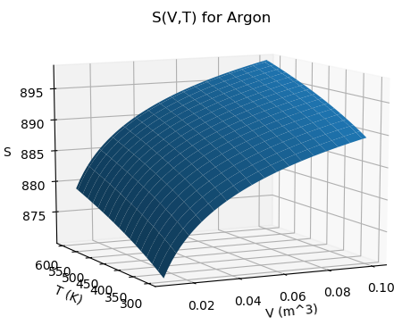



Week 10 – $S(T,V)$as a thermodynamic surface
$${\left(\frac{∂S}{∂T}\right)}_{V}$$
$${\left(\frac{∂S}{∂V}\right)}_{T}$$
Temperature
Volume
$$dS=\frac{C_{V}}{T}dT+\frac{α_{P}}{κ_{T}}dV$$

Slide 14
Week 10 – $S(T,V)$as a thermodynamic surface
$${\left(\frac{∂S}{∂T}\right)}_{V}$$
$${\left(\frac{∂S}{∂V}\right)}_{T}$$
Temperature
Volume
$$dS=\frac{C_{V}}{T}dT+\frac{α_{P}}{κ_{T}}dV$$
As volume goes up, Entropy (S) goes up

Slide 15
Week 10 – $S(T,V)$as a thermodynamic surface
$${\left(\frac{∂S}{∂T}\right)}_{V}$$
$${\left(\frac{∂S}{∂V}\right)}_{T}$$
Temperature
Volume
$$dS=\frac{C_{V}}{T}dT+\frac{α_{P}}{κ_{T}}dV$$
As temperature goes up, Entropy (S) goes up

Slide 16
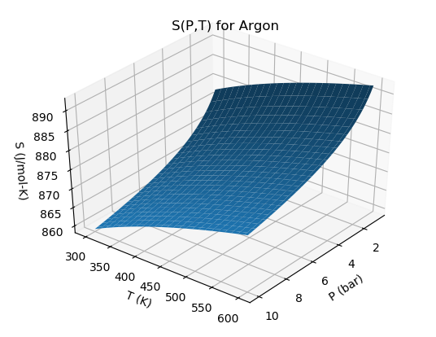



Week 10 – $S(T,P)$as a thermodynamic surface
$${\left(\frac{∂S}{∂P}\right)}_{T}$$
← Pressure
$${\left(\frac{∂S}{∂T}\right)}_{P}$$
Temperature
$$dS=\frac{C_{P}}{T}dT−α_{P}VdP$$

Slide 17
Week 10 – $S(T,P)$as a thermodynamic surface
$${\left(\frac{∂S}{∂P}\right)}_{T}$$
← Pressure
$${\left(\frac{∂S}{∂T}\right)}_{P}$$
Temperature
$$dS=\frac{C_{P}}{T}dT−α_{P}VdP$$
As pressure goes up, Entropy (S) goes down

Slide 18
Week 10 – $S(T,P)$as a thermodynamic surface
$${\left(\frac{∂S}{∂P}\right)}_{T}$$
← Pressure
$${\left(\frac{∂S}{∂T}\right)}_{P}$$
Temperature
$$dS=\frac{C_{P}}{T}dT−α_{P}VdP$$
As temperature goes up, Entropy (S) goes up

Slide 19
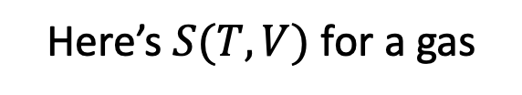
The kind of question I might ask
Here’s $S(T,V)$ for a gas
Which arrow is accompanied by a change in positional entropy (and why)?

Slide 20
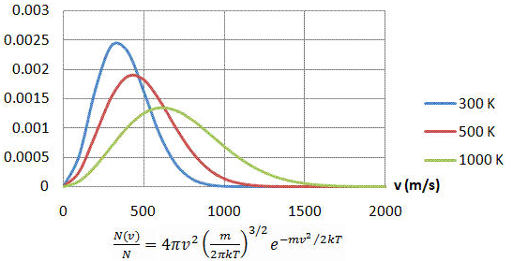

The kind of question I might ask
For a given volume of gas, which probability density corresponds to higher thermal entropy?
Probability density of molecular speeds

Slide 21
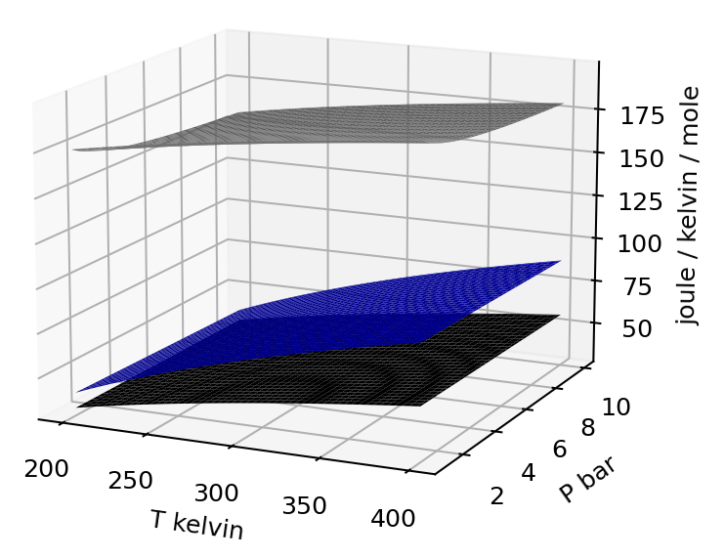

Week 10 – Entropy of different phases in T,P state space
$$dS=\frac{C_{P}}{T}dT−α_{P}VdP$$

Slide 22
The kind of question I might ask
$$dS=\frac{C_{P}}{T}dT−α_{P}VdP$$
These surfaces represent solid, liquid, and gas.
Which is which?
From your answer, which phase has the highest heat capacity?

Slide 23
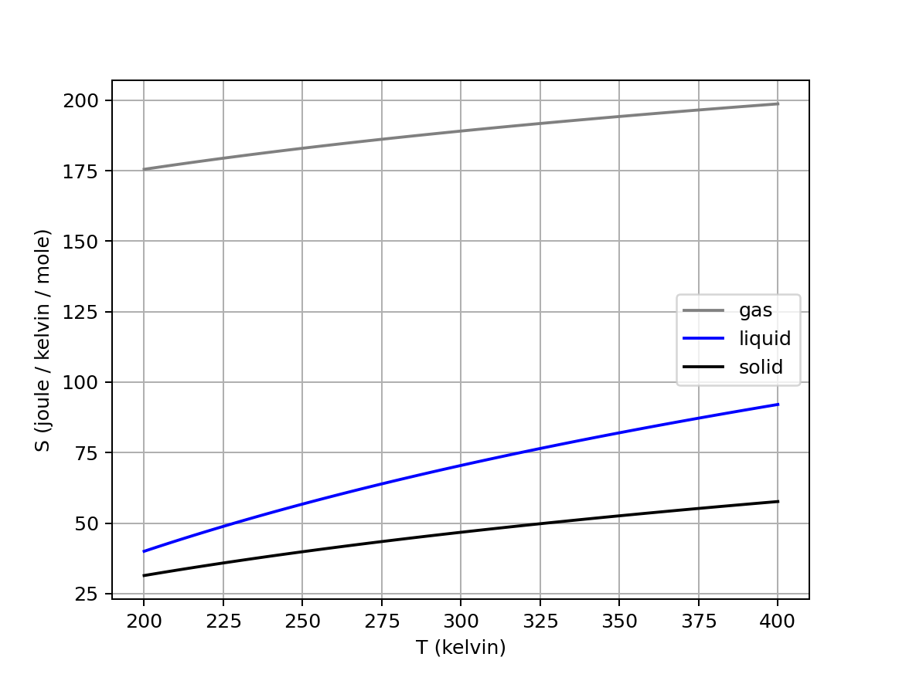
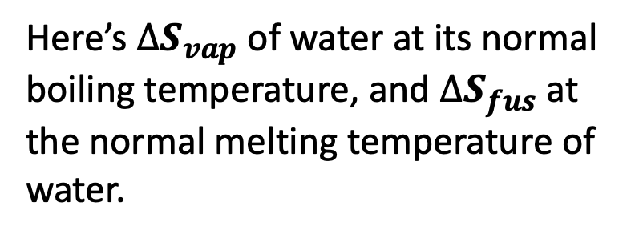
Week 10 – Entropy of phase transitions at their normal transition temperatures
Here’s $∆S_{vap}$ of water at its normal boiling temperature, and $∆S_{fus}$at the normal melting temperature of water.

Slide 24
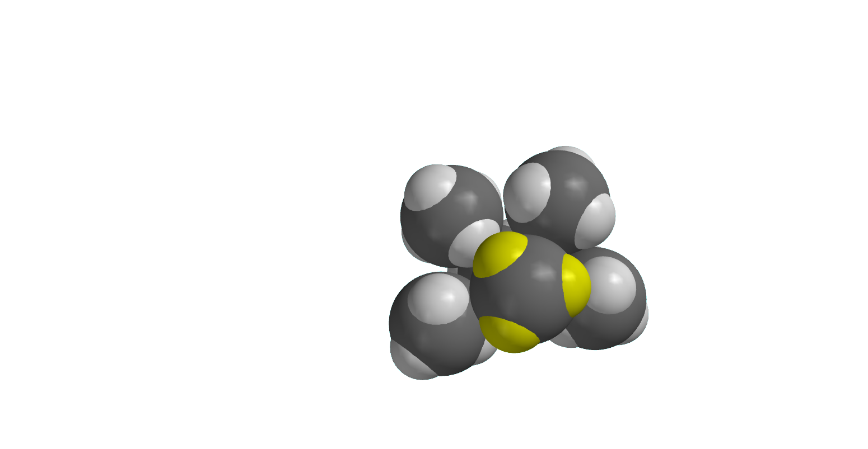
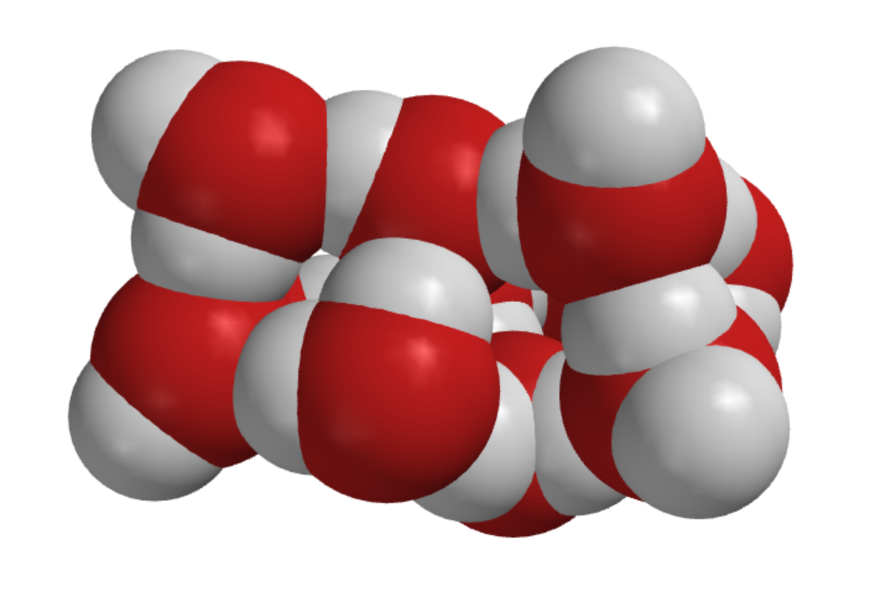
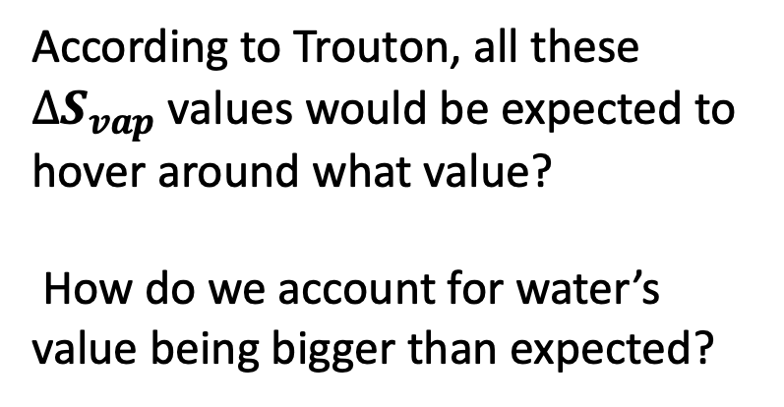
The kind of question I might ask
According to Trouton, all these $∆S_{vap}$ values would be expected to hover around what value?
How do we account for water’s value being bigger than expected?
Methane
Acetone
Water
Notes:
https://slideplayer.com/slide/7362502/

Slide 25
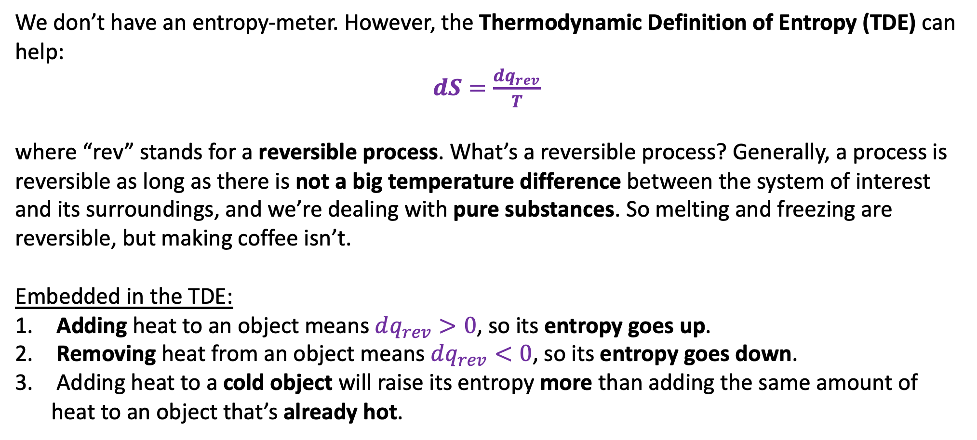
Week 10 – Thermodynamic Definition of Entropy (TDE)
We don’t have an entropy-meter. However, the Thermodynamic Definition of Entropy (TDE) can help:
$dS=\frac{dq_{rev}}{T}$
where “rev” stands for a reversible process. What’s a reversible process? Generally, a process is reversible as long as there is not a big temperature difference between the system of interest and its surroundings, and we’re dealing with pure substances. So melting and freezing are reversible, but making coffee isn’t.
Embedded in the TDE:
Adding heat to an object means $dq_{rev}>0$, so its entropy goes up.
Removing heat from an object means $dq_{rev}<0$, so its entropy goes down.
Adding heat to a cold object will raise its entropy more than adding the same amount of heat to an object that’s already hot.

Slide 26
Week 11 – The two parts of the 2nd Law
The 2nd Law divides the question of spontaneity into two parts:
A system part that we can get at using differential equations of state for the entropy, and thermodynamic tables of entropy
A surroundings part that deals with the entropy change of the surroundings due to heat transfer, that we can get at using thermodynamic tables of enthalpy

Slide 27
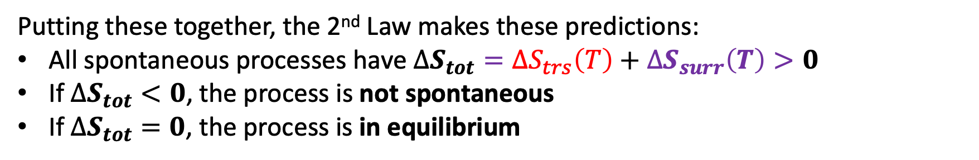
Week 11 – 2nd Law of Thermodynamics
Putting these together, the 2nd Law makes these predictions:
All spontaneous processes have $∆S_{tot}={∆S}_{trs}\left(T\right)+∆S_{surr}\left(T\right)>0$
If $∆S_{tot}<0$, the process is not spontaneous
If $∆S_{tot}=0$, the process is in equilibrium

Slide 28
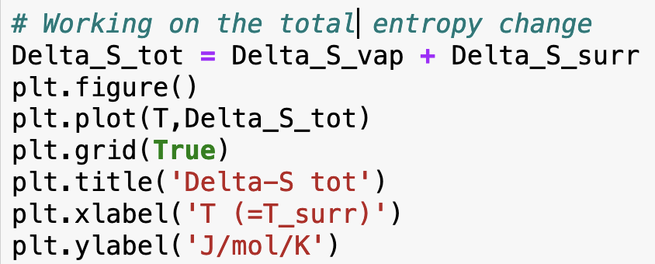
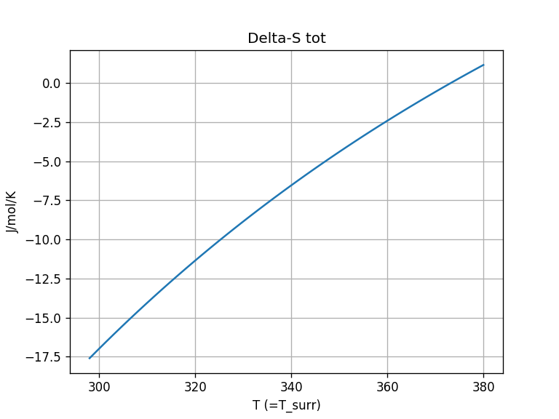
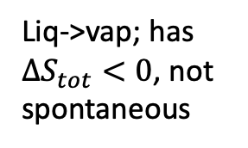
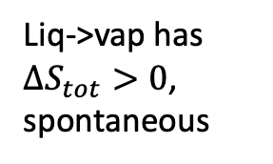
Week 11 – How you did that in Python
Liq->vap; has $∆S_{tot}<0$, not spontaneous
Liq->vap has $∆S_{tot}>0$, spontaneous

Slide 29
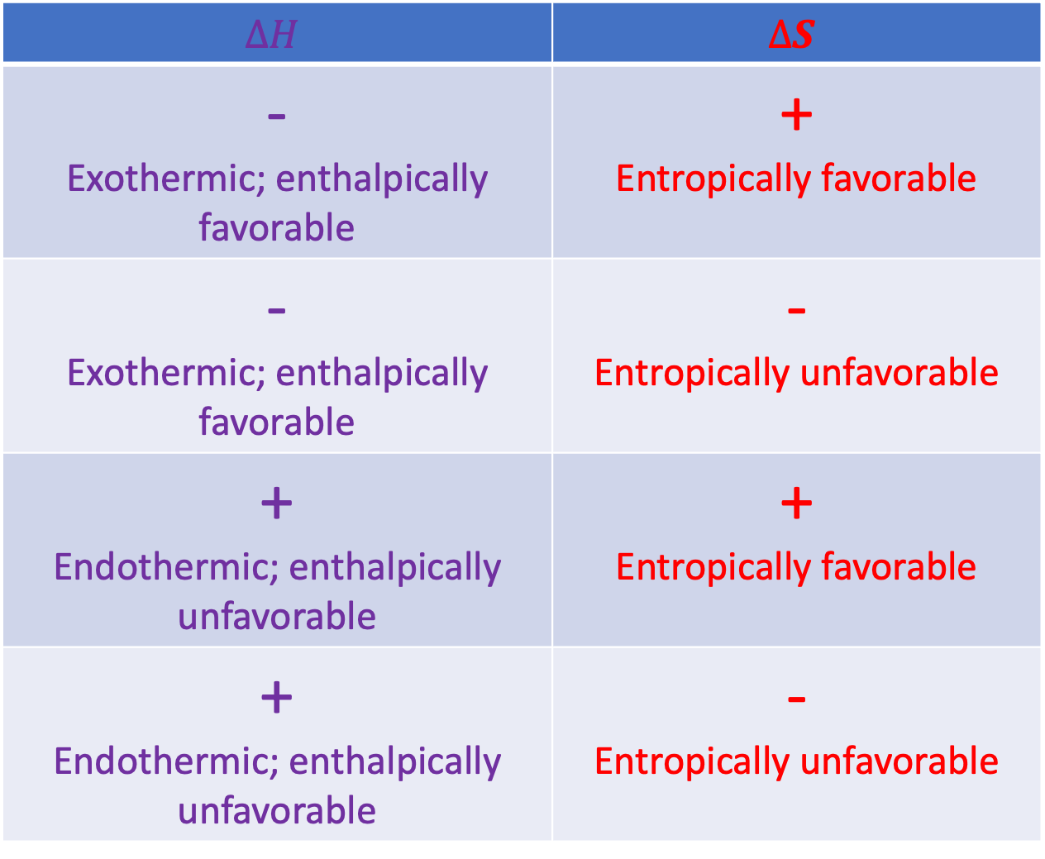
Week 11 – Systematizing the enthalpic/entropic favorability/unfavorability picture
$$∆H$$ | $$∆S$$
- Exothermic; enthalpically favorable | + Entropically favorable
- Exothermic; enthalpically favorable | - Entropically unfavorable
+ Endothermic; enthalpically unfavorable | + Entropically favorable
+ Endothermic; enthalpically unfavorable | - Entropically unfavorable

Slide 30
Week 11 – A caveat: the entropy of mixing
$∆S_{tot}=∆S+∆S_{surr}>0$ for all spontaneous processes. This is the 2nd Law
All about entropy changes of the surroundings due to heat going in/out

Slide 31
Week 11 – A caveat: the entropy of mixing
$∆S_{tot}=∆S+∆S_{surr}>0$ for all spontaneous processes. This is the 2nd Law
All about entropy changes of the surroundings due to heat going in/out
Before, we said this was all about physical changes (boiling, melting) and chemical transformations (reactions).
Now, we’re saying that it’s also about mixing.

Slide 32
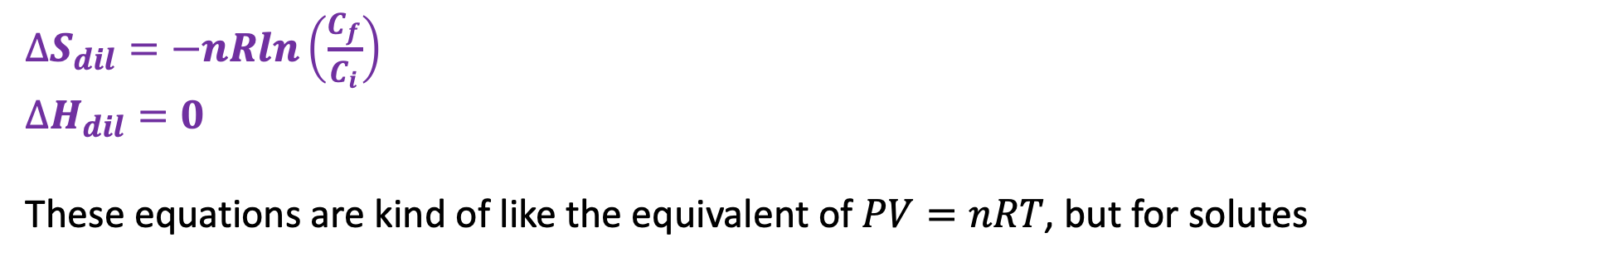
Week 11 – Entropy (and enthalpy) of dilution
$∆S_{dil}=−nRln\left(\frac{C_{f}}{C_{i}}\right)$
$∆H_{dil}=0$
These equations are kind of like the equivalent of $PV=nRT$, but for solutes

Slide 33
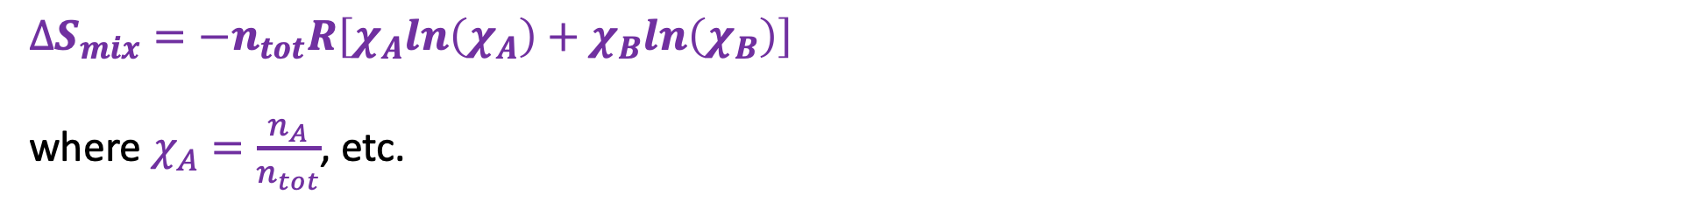
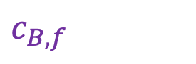
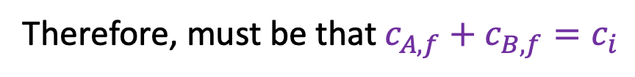
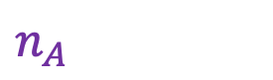
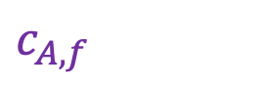
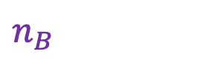

Week 11 – Entropy of mixing – the E-ICE equation
$$n_{A}$$
$$c_{B,f}$$
$$n_{B}$$
$$c_{A,f}$$
Same initial concentration “$c_{i}$”
Therefore, must be that $c_{A,f}+c_{B,f}=c_{i}$
$∆S_{mix}=−n_{tot}R\left[χ_{A}ln\left(χ_{A}\right)+χ_{B}ln\left(χ_{B}\right)\right]$
where $χ_{A}=\frac{n_{A}}{n_{tot}}$, etc.

Slide 34

Week 11 – How the “Fundamental Equations” came about
The thermodynamic definition of entropy (TDE):
$$dS=\frac{dq_{rev}}{T}$$
The 1st Law:
$$dU=dq+dw$$
Combining these*, we got the first Fundamental Equation
$$dU=TdS−PdV$$
*Subject to conditions: reversible process with PV work only

Slide 35


Week 11 – How the “Fundamental Equations” came about
$dU=TdS−PdV$
$dH=VdP+TdS$
$dG=VdP−SdT$
$dA= −SdT−PdV$
These are the four Fundamental Equations

Slide 36

The kind of question I might ask
$${\left(\frac{∂T}{∂V}\right)}_{S}=−{\left(\frac{∂P}{∂S}\right)}_{V}$$
$${\left(\frac{∂P}{∂T}\right)}_{V}={\left(\frac{∂S}{∂V}\right)}_{T}$$
$${\left(\frac{∂T}{∂P}\right)}_{S}={\left(\frac{∂V}{∂S}\right)}_{P}$$
$${\left(\frac{∂S}{∂P}\right)}_{T}=−{\left(\frac{∂V}{∂T}\right)}_{P}$$
How do you get these Maxwell Relations from from the four Fundamental Equations?
$dU=TdS−PdV$
$dH=VdP+TdS$
$dG=VdP−SdT$
$dA= −SdT−PdV$
These are the four Fundamental Equations

Slide 37



The kind of question I might ask
Something is dreadfully wrong here … what?

Slide 38



Weeks 12/13 – $G(T,P)$as a thermodynamic surface
$${\left(\frac{∂G}{∂T}\right)}_{P}$$
$${\left(\frac{∂G}{∂P}\right)}_{T}$$
Pressure
Temperature
$$dG=−SdT+VdP$$

Slide 39
Weeks 12/13 – $G(T,P)$as a thermodynamic surface
$${\left(\frac{∂G}{∂T}\right)}_{P}$$
$${\left(\frac{∂G}{∂P}\right)}_{T}$$
Pressure
Temperature
As pressure goes up, Gibbs energy (G) goes up
$$dG=−SdT+VdP$$

Slide 40
Weeks 12/13 – $G(T,P)$as a thermodynamic surface
$${\left(\frac{∂G}{∂T}\right)}_{P}$$
$${\left(\frac{∂G}{∂P}\right)}_{T}$$
Pressure
Temperature
$$dG=−SdT+VdP$$
As temperature goes up, Gibbs energy (G) goes down

Slide 41


Weeks 12/13 – Intersecting $G(T,P)$ thermodynamic surfaces
Liquid
P
Gas
The intersection defines a phase boundary, where
$\frac{dP}{dT}=\frac{∆S_{trs}}{∆V_{trs}}=\frac{∆H_{trs}}{T ∆V_{trs}}$ (Clapeyron Equation)
T

Slide 42

Weeks 12/13 – Thermodynamics of burning a mole of coal
Only about 40% gets turned into useful electrical energy
Heat fuels an electricity-generating power plant
394 kJ/mol heat
158 kJ/mol electrical energy
Furnace

Slide 43






Weeks 12/13 – Thermodynamics of burning a mole of coal
$$C_{atm}=0.00042 bar$$
$$q_{hot}=394\frac{kJ}{mol}$$
But $CO_{2}$ is released too
$$w_{tot}=−158\frac{kJ}{mol}$$
The cost of concentration alone
$\frac{19}{158}=12\%$ of the electrical power we get from burning coal will have to be spent (by “somebody else”) to remove that $CO_{2}$ from the air.
$∆G_{conc}$ $=+19\frac{kJ}{mol}$
Furnace

Slide 44






Weeks 12/13 – Gibbs energy of a reaction mixture ($A→B$)
${G=G}^{o}+∆G_{mix}$
$$G^{o}$$
$$∆G_{mix}$$
$$G$$
$$ε$$
$G$ < $G^{o}$ because $∆G_{mix}<0$

Slide 45



Weeks 12/13 – Gibbs energy of a reaction mixture ($A→B$)
The slope of the Gibbs energy along the reaction path told us how far a reaction will proceed:
As long as ${\left(\frac{∂G}{∂ε}\right)}_{rxn}<0$, the reaction moves forward (makes more $B$)
As long as ${\left(\frac{∂G}{∂ε}\right)}_{rxn}>0$, the reaction moves backward (makes more $A$)
If ${\left(\frac{∂G}{∂ε}\right)}_{rxn}=0$, the reaction is at equilibrium
At equilibrium, there’s a certain ratio of B to A. That’s the equilibrium constant, K
$$ε$$

Slide 46



Weeks 12/13 – Chemical potentials – they’re just slopes in the $n_{A}$, $n_{B}$ state space
$$μ_{A}≡{\left(\frac{∂G}{∂n_{A}}\right)}_{n_{B}, T,P}$$
$$μ_{B}≡{\left(\frac{∂G}{∂n_{B}}\right)}_{n_{A}, T,P}$$
$$μ_{A}≡{\left(\frac{∂G}{∂n_{A}}\right)}_{n_{B}, T,P}$$

Slide 47


Weeks 12/13 – The chemical potential formula (CPF) and equilibria
$$ε$$
We said
$$μ_{A}=μ_{A}^{o}+RT ln{(a}_{A})$$
(you can find $μ_{A}^{o}=∆G_{f}^{o}(A)$ in tables). Similar for B.

Slide 48


Weeks 12/13 – The chemical potential formula (CPF) and equilibria
$$ε$$
Defined ${\left(\frac{∂G}{∂ε}\right)}_{rxn,T,P}≡∆G_{rxn}(ε)$
Then, we
showed that $∆G_{rxn}=∆G_{rxn}^{o}+RT ln⁡(Q_{rxn})$ anywhere along the reaction path
showed that $∆G_{rxn}^{o}=−RT ln⁡(K)$ at equilibrium

Slide 49

Weeks 12/13 – How $∆G_{rxn}(ε)$ depends on reaction stoichiometry
What if the reaction path is $A→2B$?
$$∆G_{rxn}\left(ε\right)=∆G_{rxn}^{o}+nRT ln{(Q}_{rxn})$$
where $Q_{rxn}≡\frac{a_{B}^{2}}{a_{A}}$. As before, at equilibrium we know that $∆G_{rxn}\left(ε\right)=0$, with particular values of $a_{A}$ and $a_{B}$, hence
$$∆G_{rxn}^{o}+nRT ln(K)$$
Which means … that if you measure $K$ in the lab, you can figure out $∆G_{rxn}^{o}!$

Slide 50

Weeks 12/13 – A generalization of the CPF
$$μ_{A}=μ_{A}^{o}+RT ln\frac{a_{A}}{a^{o}}$$
The $μ_{A}^{o}$ part is $∆G^{o}$ of the substance A – the Gibbs energy of a pure, unmixed substance in what we have been calling its standard state
The $nRT ln\frac{a_{A}}{a^{o}}$ part takes into account the mixing or dilution
The generic name for $a_{A}$ is defined as the substance’s activity:
If A is a solute, $a_{A}=$ $C_{A}$ (concentration of A), and $a^{o}=1 \underline{M}$
If A is a gas, $a_{A}=$ $P_{A}$ (partial pressure of A, and $a^{o}=1 bar$
If A is a solvent, $a_{A}= χ_{A}$ (mole fraction of A) and $a^{o}=1$

Slide 51

Weeks 12/13 – A generalization of the CPF
$$μ_{A}=μ_{A}^{o}+RT ln\frac{a_{A}}{a^{o}}$$
The $μ_{A}^{o}$ part is $∆G^{o}$ of the substance A – the Gibbs energy of a pure, unmixed substance in what we have been calling its standard state
The $nRT ln\frac{a_{A}}{a^{o}}$ part takes into account the mixing or dilution
The generic name for $a_{A}$ is defined as the substance’s activity:
If A is a solute, $a_{A}=$ $C_{A}$ (concentration of A), and $a^{o}=1 \underline{M}$
If A is a gas, $a_{A}=$ $P_{A}$ (partial pressure of A, and $a^{o}=1 bar$
If A is a solvent, $a_{A}= χ_{A}$ (mole fraction of A) and $a^{o}=1$
In case you run into it: thermodynamicists like to fudge those definitions to force $μ_{A}$to be equal to $μ_{A}^{o}+RT ln\frac{a_{A}}{a^{o}}$. So for example they’ll say (for a solute) that $a_{A}=$ $C_{A}$ $×$ $γ$, where $γ$ is the fudge factor.

Slide 52


Weeks 12/13 – Derivation of the Clapeyron equation
$dG_{gas}=−S_{gas}dT+V_{gas}dP$
$dG_{liq}=−S_{liq}dT+V_{liq}dP$
In going from A to B, it must be that $dG_{gas}=dG_{liq}$
Then you showed how this led to Clapeyron
$$\frac{dP}{dT}=\frac{∆H_{vap}}{T ∆V_{vap}}$$
B
A

Slide 53



Weeks 12/13 – CPF and osmosis
Chamber X is a 1 M solution of NaCl(aq). Chamber Y is pure water.
$$∆P$$
Y
X
We could apply extra pressure $∆P$ to compensate
$$H_{2}O$$
$$(+solute)$$
$$H_{2}O\left(l\right)$$
$$(pure)$$
What direction does your intuition tell you is the direction of spontaneous change?
That means $μ_{A}(Y)>μ_{A}(X)$.

Slide 54



Weeks 12/13 – CPF and osmosis
Chamber X is a 1 M solution of NaCl(aq). Chamber Y is pure water.
$$∆P$$
Y
X
When $∆P$ exactly compensates, we call it the osmotic pressure of solution X
$$H_{2}O$$
$$(+solute)$$
$$H_{2}O\left(l\right)$$
$$(pure)$$
Analysis (which comes from $dG=−SdT+VdP$):
$μ_{H_{2}O, X}=μ_{H_{2}O}^{o}+RTln\left(χ_{H_{2}O}\right)+V∆P$
$μ_{H_{2}O, Y}=μ_{H_{2}O}^{o}$
where $V$ is the volume of one mole of water. We could solve this to find $∆P$, if we knew $χ_{H_{2}O}$.
To get $χ_{H_{2}O}$, we need to know that pure water has a concentration of 55.6 M, so in 1 M NaCl(aq),
$χ_{H_{2}O}=\frac{55.6}{55.6+2}=0.96$

Slide 55


Weeks 12/13 – Gibbs-Helmholtz
We can look up $∆G_{rxn}^{o}$ at standard temperature ($T=298 K$), but what is it at a other temperatures (say $T=400 K$)?
Gibbs-Helmholtz allows us to make a prediction subject only to the assumption that $∆H_{rxn}^{o}$ is constant over the desired temperature range (which is often a pretty good assumption).
$$T_{1}$$
$$T_{2}$$

Slide 56
The kind of question I might ask
Compared to the liquid surface, how do we know that the gas surface must be
steeper in the pressure direction?
steeper in the temperature direction
Liquid
Gas

Slide 57

The kind of question I might ask
If a reaction mixture of $A$ and $B$ had the composition shown by the red dot, we would predict that the reaction $A→B$ …
Would spontaneously go “forward” (make more $B$)
Would spontaneously go “backward” (make more $A$)
Would be at equilibrium

Slide 58

The kind of question I might ask
Matching:
The Thermodynamic Definition of Entropy
The 2nd Law of Thermodynamics
One of the four fundamental differential equations of Thermodynamics
A Maxwell relation
$dU=TdS−PdV$
$dS=−P_{ex}dV$
$dS=\frac{dq_{rev}}{T}$
$dS_{tot}>0$ for spontaneous processes
${\left(\frac{∂S}{∂V}\right)}_{T}={\left(\frac{∂P}{∂T}\right)}_{V}$
$dG=dw^{′}$

Slide 59


The kind of question I might ask
$$μ_{A}=μ_{A}^{o}+RT ln\frac{a_{A}}{a^{o}}$$
If A is a solvent, then
$a_{A}=$ concentration (molarity) of A, and $a^{o}=1$ $M$
$a_{A}=$ partial pressure of A (bar), and $a^{o}=1 bar$
$a_{A}= χ_{A}$, and $a^{o}=1$

Slide 60

Week 14 – Thermophoresis
Etymology: thermo (“heat”) + phoresis (“to carry”)

Slide 61


Week 14 – Frequency of the $R−NH_{2}$ (scissor) vibrational frequency
$${\overline{ν}}_{LT}$$

Slide 62




Week 14 – $Z′$ (the unscaled part of the partition function)
$Z′$ is the number of vibrational states that are accessible to a molecule.
The temperature is high enough now that $n=1$ and $n=2$ are thermally accessible -- so $Z′$ is getting even bigger!
$$E_{gap}$$
Summary for $Z′$:
At really low temperature, collisions with surrounding molecules don’t have enough energy to populate excited states, so $Z′≈1$.
At higher temperature, more and more excited vibrational states are accessible, so $Z^{′}>1$.

Slide 63









Week 14 – Getting $Z′$ from $\overline{ν}$ and $T$
Start with $\overline{ν}$, the frequency of vibration you got from Spartan
$$E_{gap}=N_{A}ℏ2πc\overline{ν}$$
$$∆E_{n}={nE}_{gap}$$
$$E_{gap}$$
$$E_{gap}$$
$Z_{n}^{′}=exp⁡(−∆E_{n}/RT)$
$$E_{gap}$$
$$E_{gap}$$
$Z′=\sum_{n}{Z_{n}^{′}}$
$$E_{gap}$$

Slide 64






Week 14 – From $Z_{n}′$ $→ Z^{′}$
$Z_{n}′$
$Z^{′}$
Notice that $Z^{′}$is a function of distance ($x$) only, since we’ve summed over quantum numbers ($n$)

Slide 65

The kind of question I might ask
Suppose the temperature is such that $\frac{3}{2}RT≈4\frac{kJ}{mol}$. Which statement(s) are compatible with $Z′$ being significantly greater than 1?
$E_{gap}=200\frac{kJ}{mol}$
$E_{gap}=20\frac{kJ}{mol}$
$E_{gap}=2\frac{kJ}{mol}$
$E_{gap}=0.2\frac{kJ}{mol}$
None of these
All of these
$$E_{gap}$$
$$E_{gap}$$
$$E_{gap}$$
$$E_{gap}$$
$$E_{gap}$$

Slide 66







The kind of question I might ask (needs work)
$${∆U}_{sol}$$
$${∆U}_{sol}$$
$${∆U}_{sol}$$
A
C
B
D

Slide 67





Week 15 – Fractional distillation
cold
vapor composition
hot
liquid composition

Slide 68

The kind of question I might ask
https://www.researchgate.net/profile/Vera-Montalbano/publication/259470569/figure/fig2/AS:614303761723443@1523472838539/Boiling-point-in-function-of-liquid-composition-of-a-mixture-of-ethanol-and-water-at-a.png

